Slide 1

PGP Batch 2
Capstone Project- Credit Card Manager- Team 1

Slide 2
Agenda
Team Introduction – with Photo
Capstone Project Overview
Scope and Objective
Capstone Project solution design & solution implementation
Diagrams ( Architecture, Use Case, Class Diagrams, Sequence etc., )
Screen shots(Frontend & Backend)
Technology Stack
NFRs
Best Practices followed during solution implementation
Challenges faced during solution design & solution implementation
Individual Contribution
Learnings & Experiences
Future Scope

Slide 3
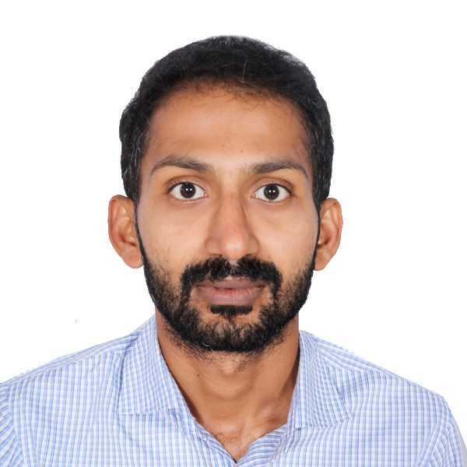


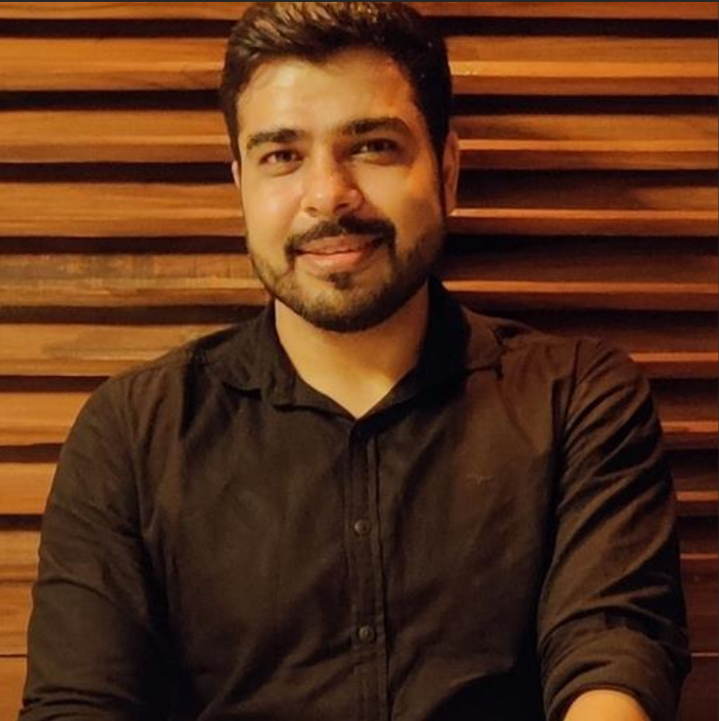
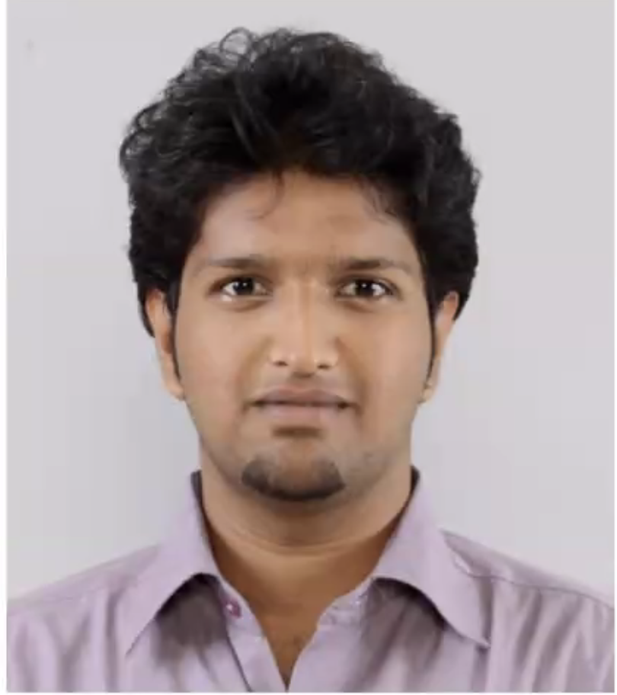

Team introduction – Team 1
Nitinchandra Sp
Software Engineer III
nitinchandra.sp@walmart.com
Diwya Sinha
Solution Consultant III
Diwya.Sinha@walmart.com
Venkatarami Reddy Challa
Systems and Infrastructure
Engineer III
Venkatarami.Reddy.Challa@walmart.com
Atul Pahlazani
Systems and Infrastructure
Engineer III
atul.pahlazani@walmart.com
Vijay Ganesh
Senior Software Engineer
Vijay.Ganesh@walmart.com
Vijaya Jimmidi
Senior Software Engineer
Jimmidi.Vijaya0@walmart.com

Slide 4
Capstone Project Overview -
The project, named Credit Card Manager, is a collaborative effort aimed at creating a scalable, secure, and feature-rich platform for customer account, credit card, and transaction management. The name Credit Card Manager reflects the primary goal of the application: empowering users to seamlessly manage their credit cards, track transactions, and gain actionable insights into their spending habits. The platform is designed to address the challenges customers face in organizing and monitoring their financial activities, offering a centralized solution for convenience, transparency, and control.
This project integrates functionality across Backend, Frontend, DevOps, and Cloud domains to deliver a seamless user experience while maintaining high standards of performance, reliability, and security. The development has been divided into three teams, each responsible for distinct areas, ensuring focused execution and modular design.

Slide 5






Scope -
To develop a secure, user-friendly, and scalable platform for efficient management of credit cards and financial activities.
1. Customer Registration and Management
User registration and account customization.
Secure login for accessing financial data.
3. Backend and API Development
Robust backend for business logic and validations.
Seamless interaction with the database.
5. DevOps
Continuous Integration/Continuous -
Deployment (CI/CD).
Automated quality checks and containerized
deployments.
2. Credit Card Operations
Add, view, enable/disable, and delete credit cards.
Ensure data integrity and operational flexibility.
4. Frontend Design
Responsive, intuitive UI for mobile, tablet, and desktop.
Focus on smooth and consistent user experience.
6. Cloud Infrastructure
Leverage cloud services for hosting and infrastructure scalability to handle high user demands securely and reliably.
Use of CDN and cloud-based infrastructure for reliability.

Slide 6
Objective -
Create a comprehensive platform that simplifies credit card and transaction management while ensuring security, scalability, and usability.
1. Ease of Use
Intuitive, responsive interface for managing credit cards, transactions, and account settings.
3. Actionable Insights
Provide meaningful financial insights to help customers make informed decisions.
5. Efficiency
Leverage DevOps practices: CI/CD pipelines, containerization, and quality checks.
7. Modular Design
Divide development into modular components to improve collaboration and maintain clarity.
2. Data Security and Privacy
Secure authentication methods.
Compliance with industry standards to protect sensitive information.
4. Reliability and Performance
Robust backend capable of handling high transaction volumes.
Ensure consistent uptime and fast response times.
6. Scalable Infrastructure
Utilize cloud technologies like AWS EC2, S3, and CloudFront for seamless scaling.

Slide 7
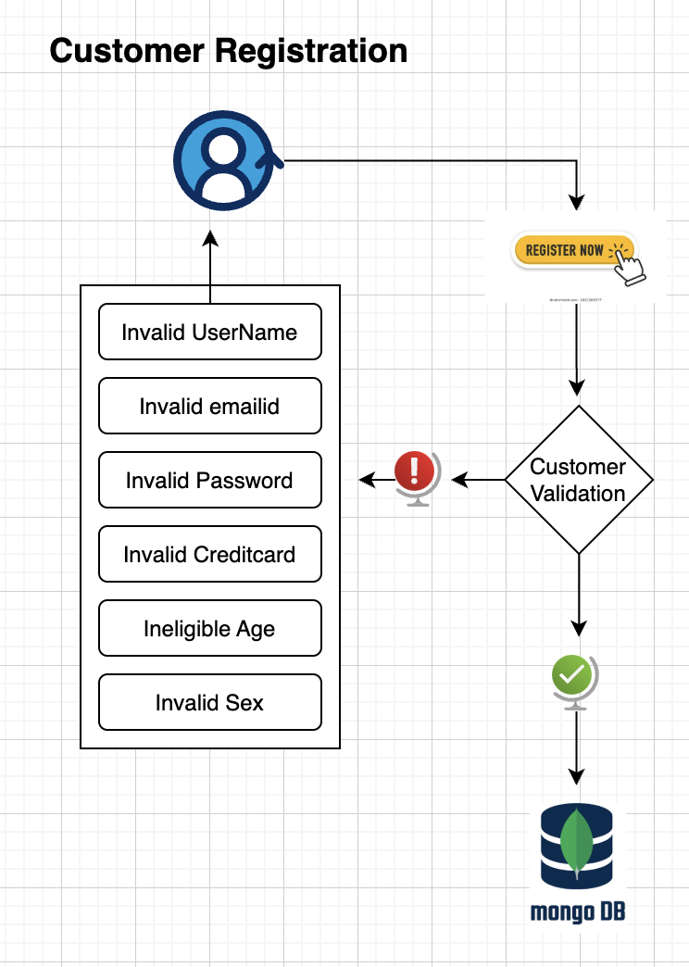
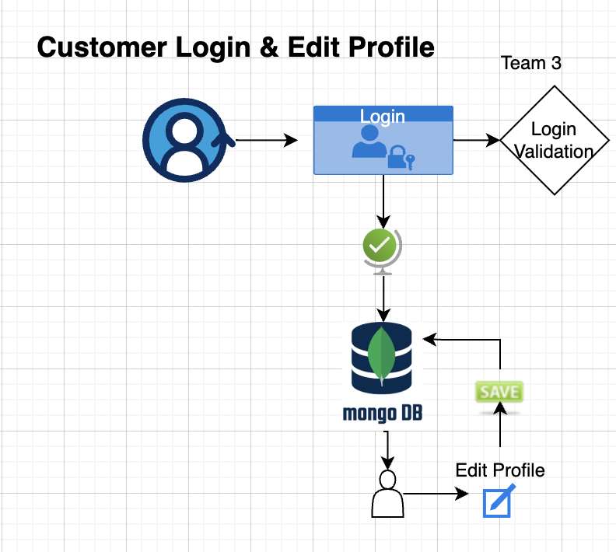
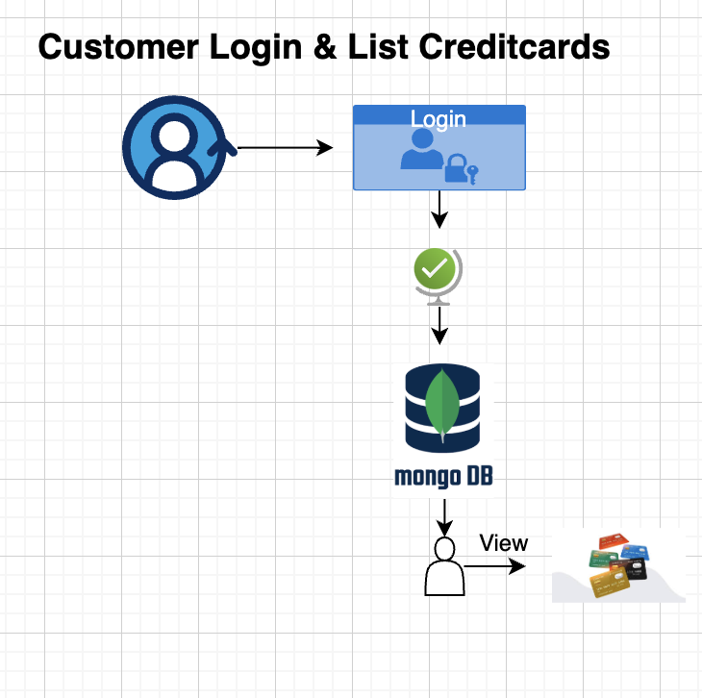
Capstone Project solution design & solution implementation
High Level Architecture
Edit email
Edit address

Slide 8
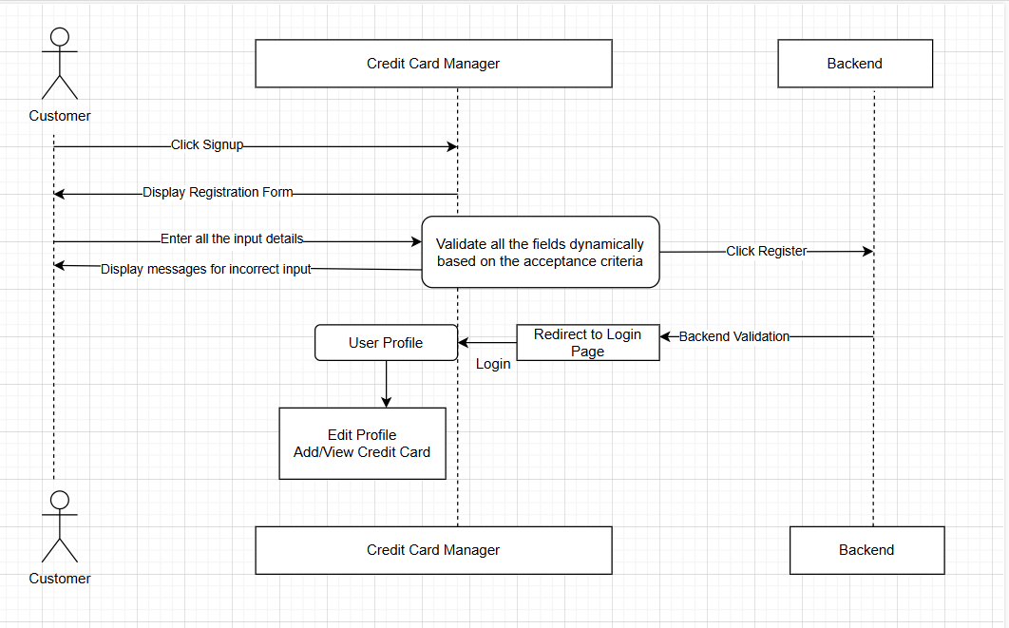
Capstone Project solution design & solution implementation
Use Case Diagram

Slide 9
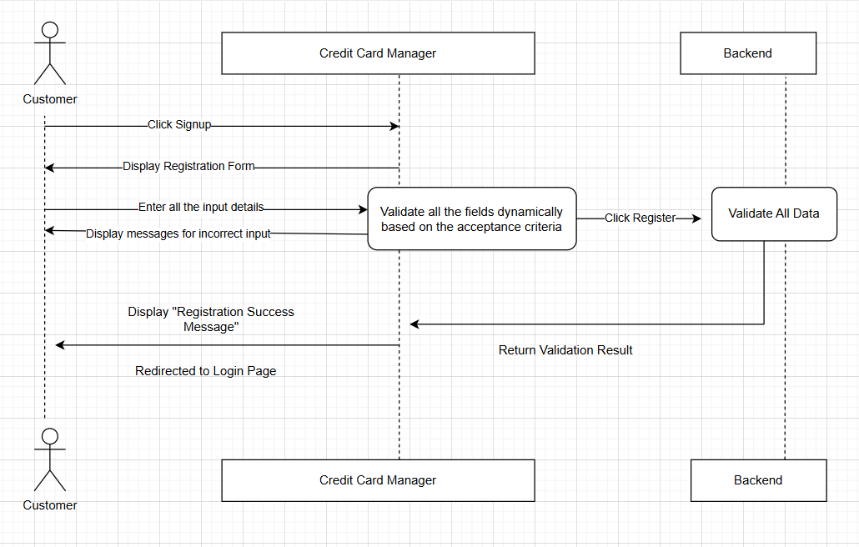
Capstone Project solution design & solution implementation
Customer Registration-Use Case Diagram

Slide 10
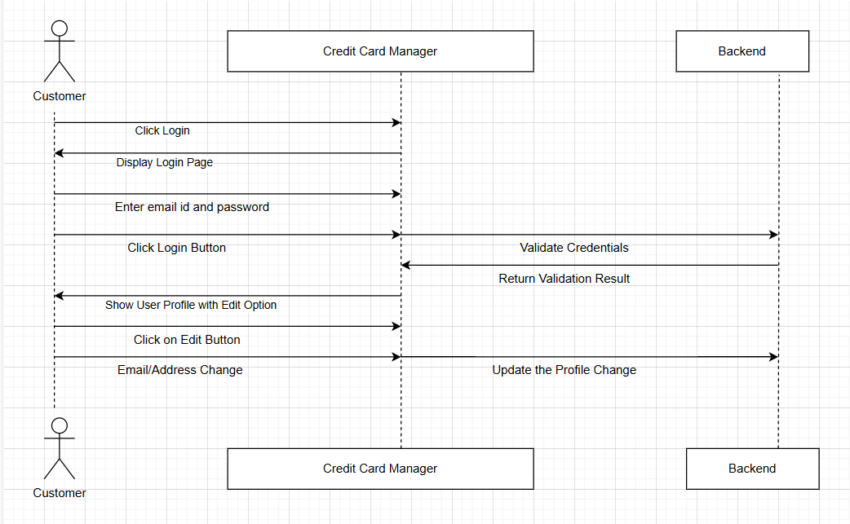
Capstone Project solution design & solution implementation
Edit Profile-Use Case Diagram

Slide 11
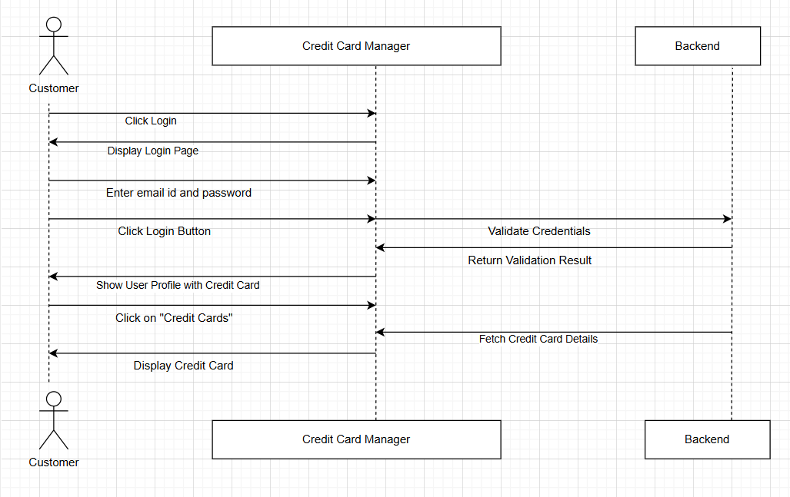
Capstone Project solution design & solution implementation
Credit Card Display-Use Case Diagram

Slide 12
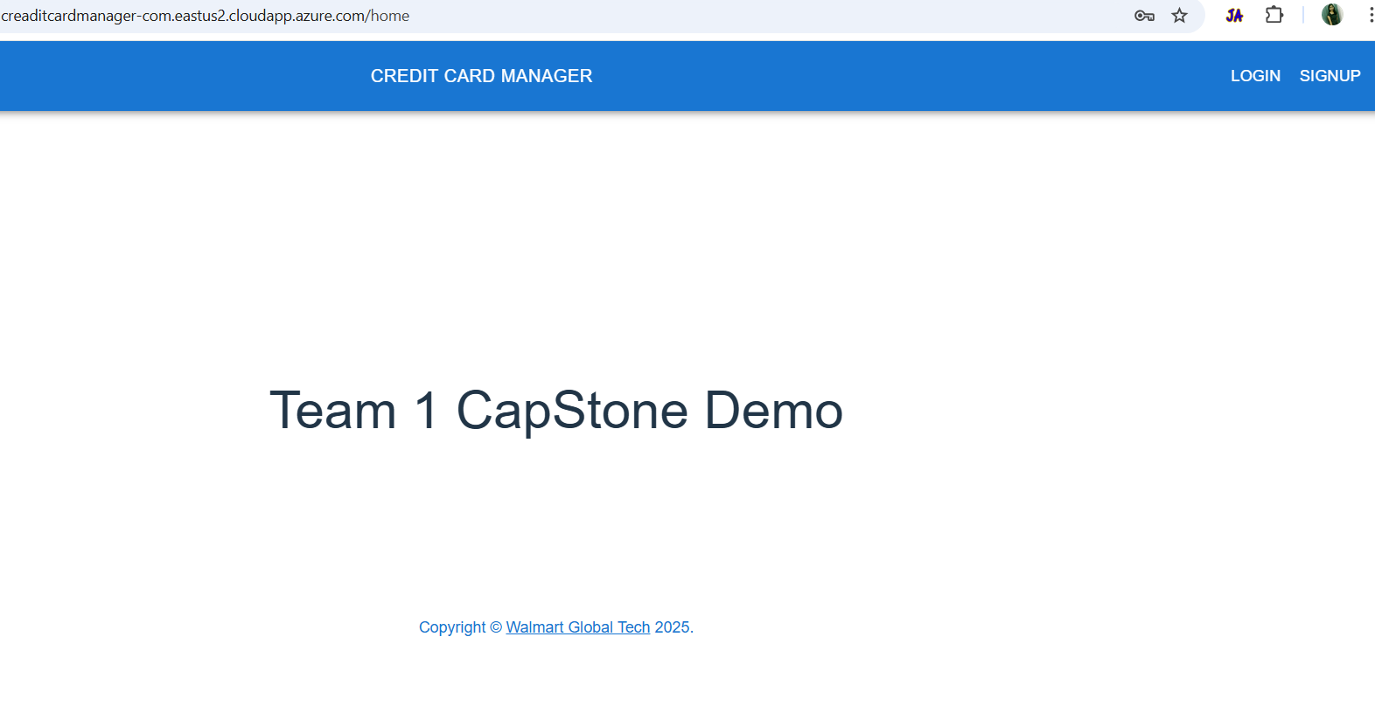
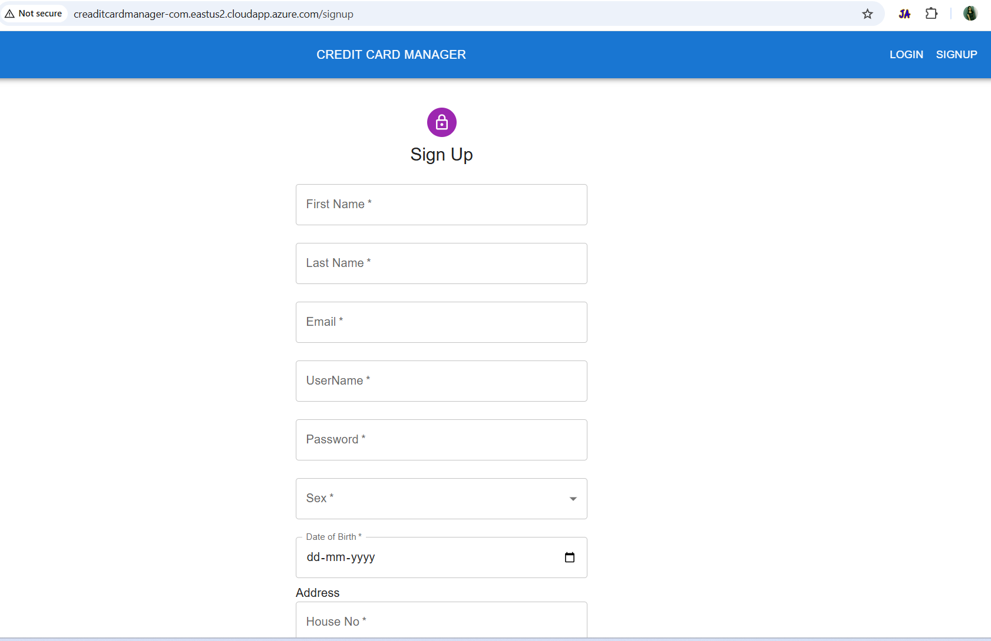
Capstone Project solution design & solution implementation
Registration Page
Click here Credit Card Manager to login

Slide 13
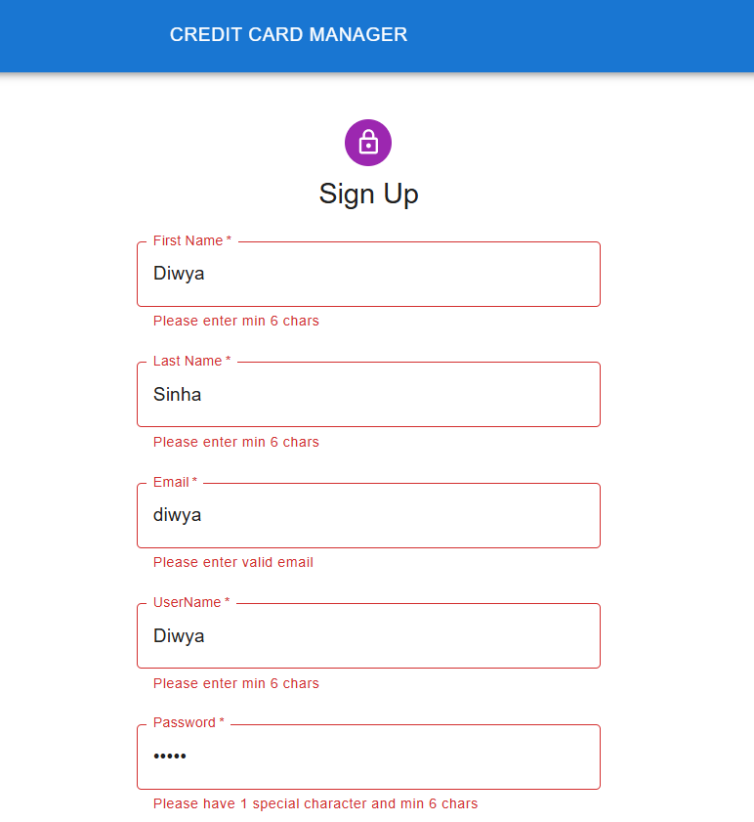
Capstone Project solution design & solution implementation
Screenshots
Validation on this screen
First Name- Should be minimum 6 characters
Last Name- Should be minimum 6 characters
Email- Should be with correct format
UserName- Should be minimum 6 characters
Password- Should be minimum 6 characters including a special character

Slide 14
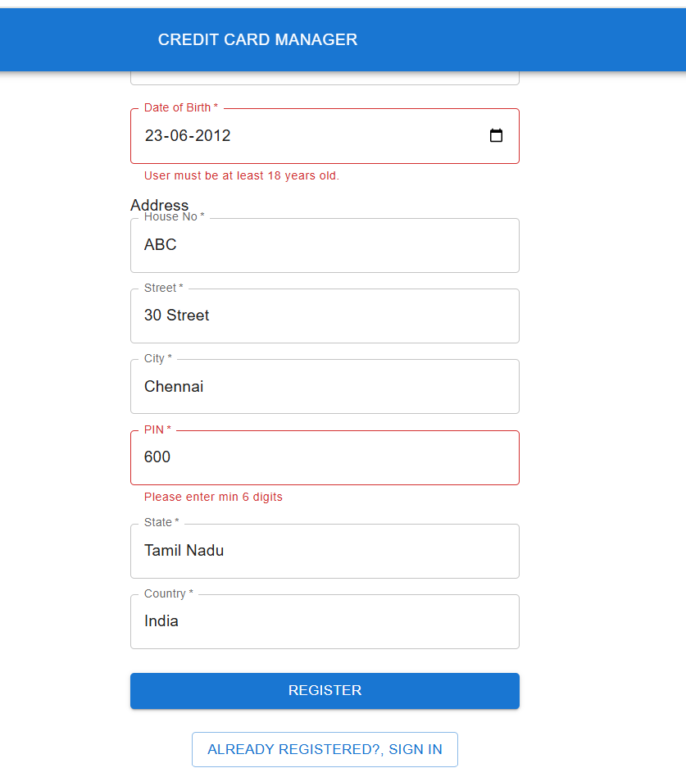
Capstone Project solution design & solution implementation
Screenshots
Validation on this screen
Date of Birth- Invalid Date as user must be at least 18 years of age
PIN- Must have 6 digits

Slide 15
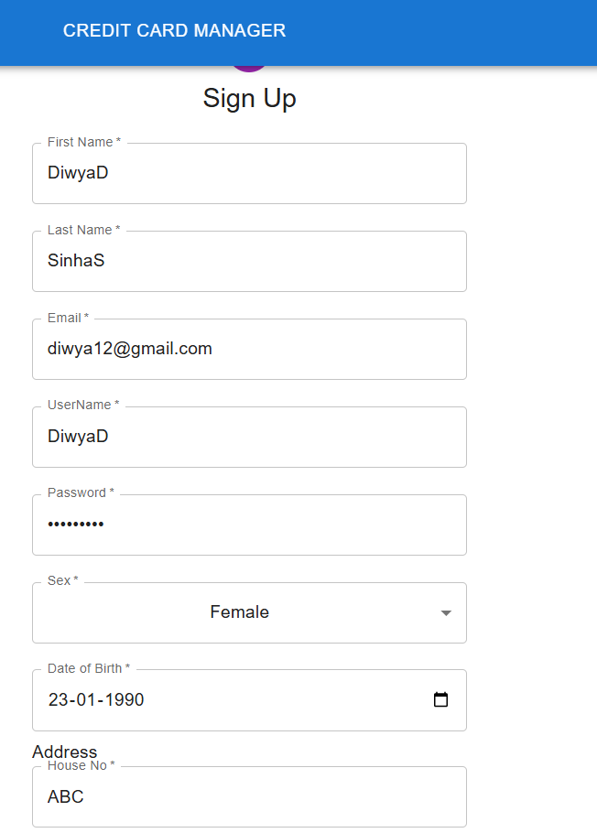
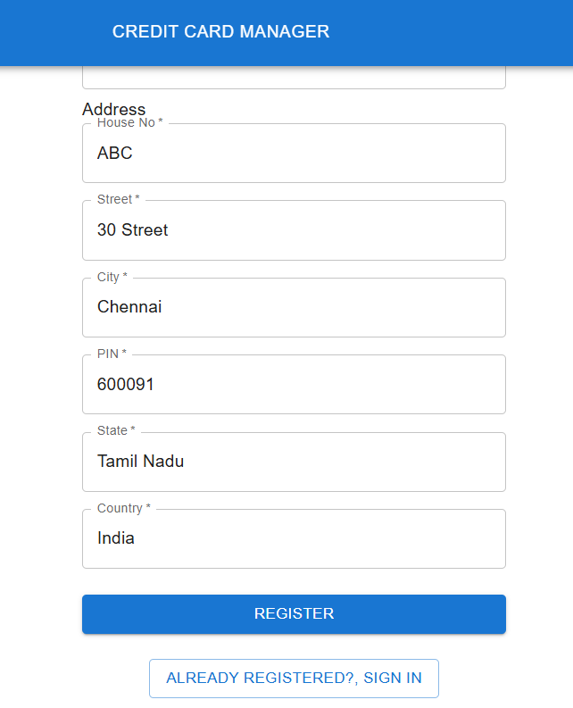
Capstone Project solution design & solution implementation
Registration Form
Once all the validation are successful, user can click on register button

Slide 16
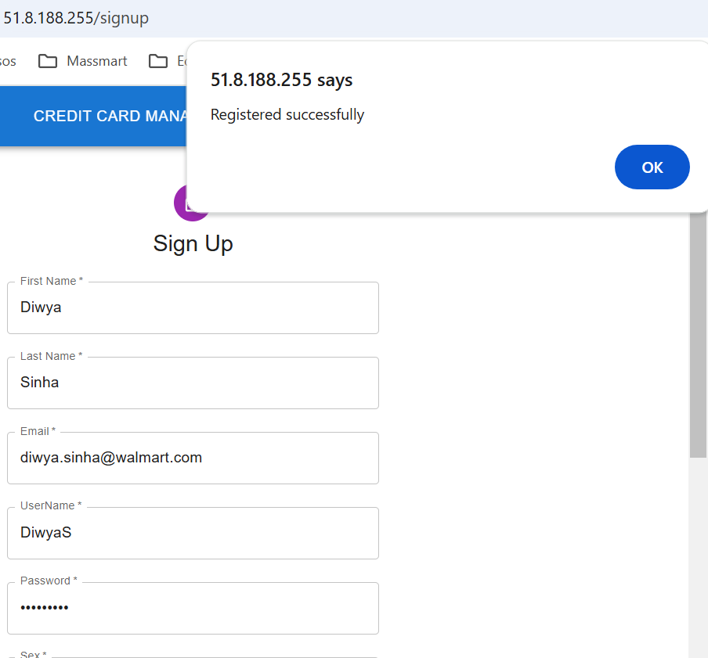
Capstone Project solution design & solution implementation
Registration Successful
The validation for First Name and Last Name, which previously required a minimum of 6 characters, was updated to improve user experience. The original restriction was not user-friendly, as names can often be shorter than 6 characters.

Slide 17
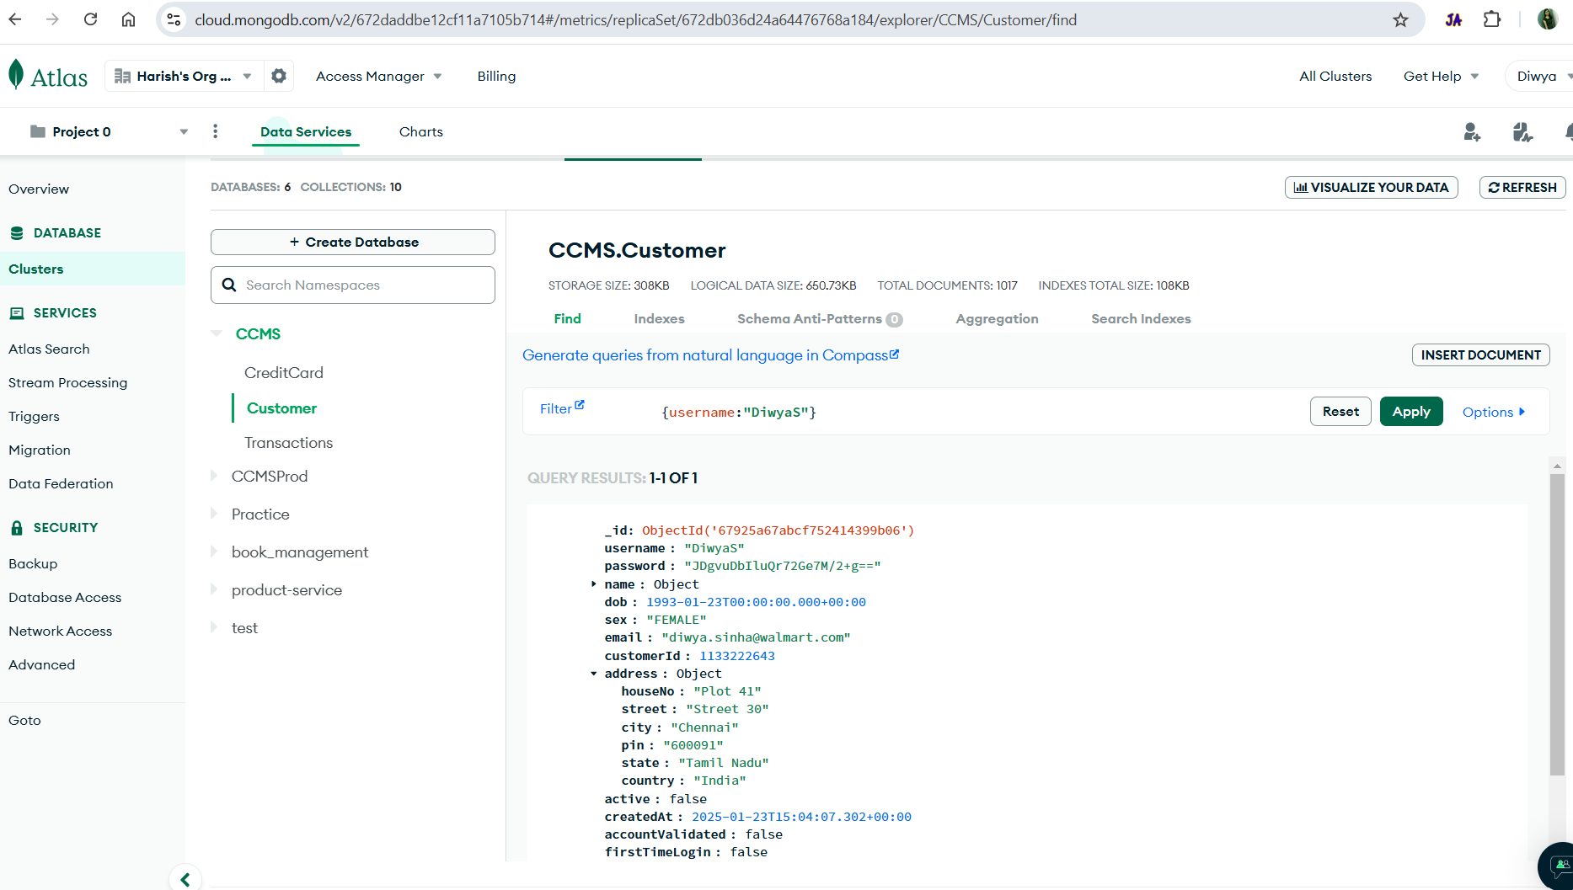
Capstone Project solution design & solution implementation
Customer Registration - A record was successfully updated in the customer database.

Slide 18
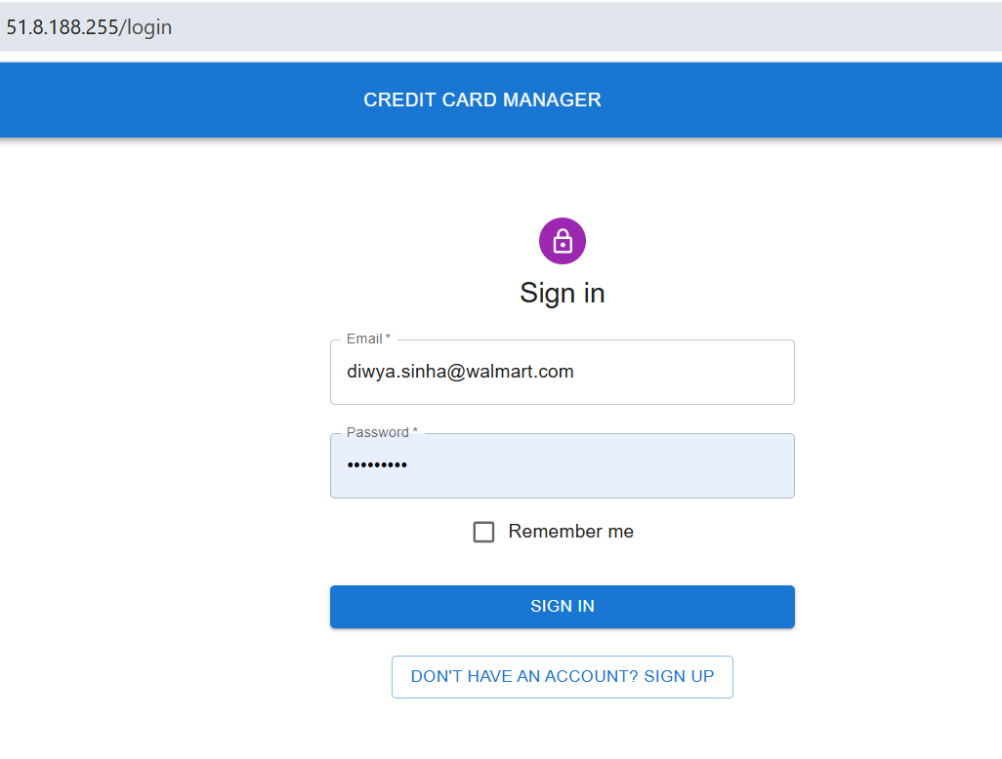
Capstone Project solution design & solution implementation
After registration, user will be redirected to login page

Slide 19
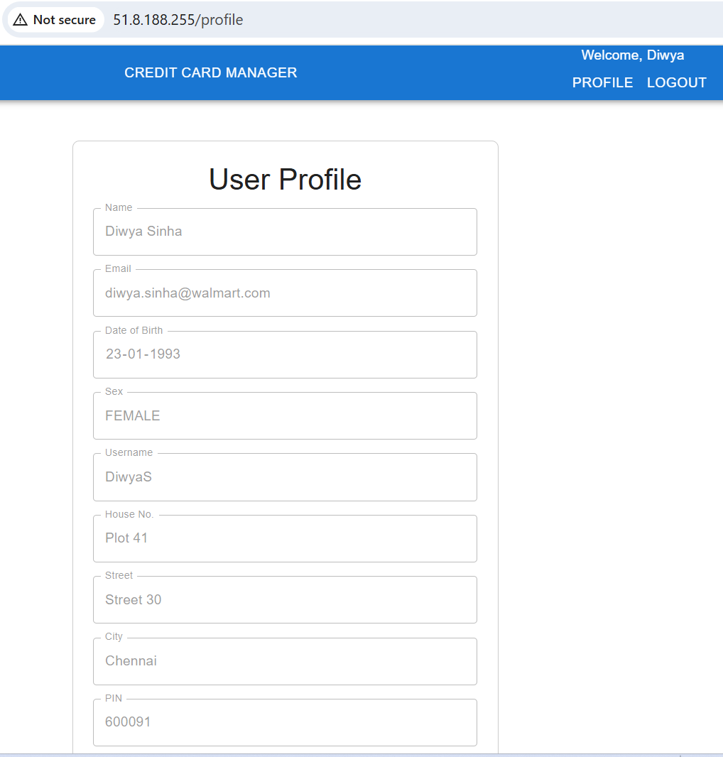
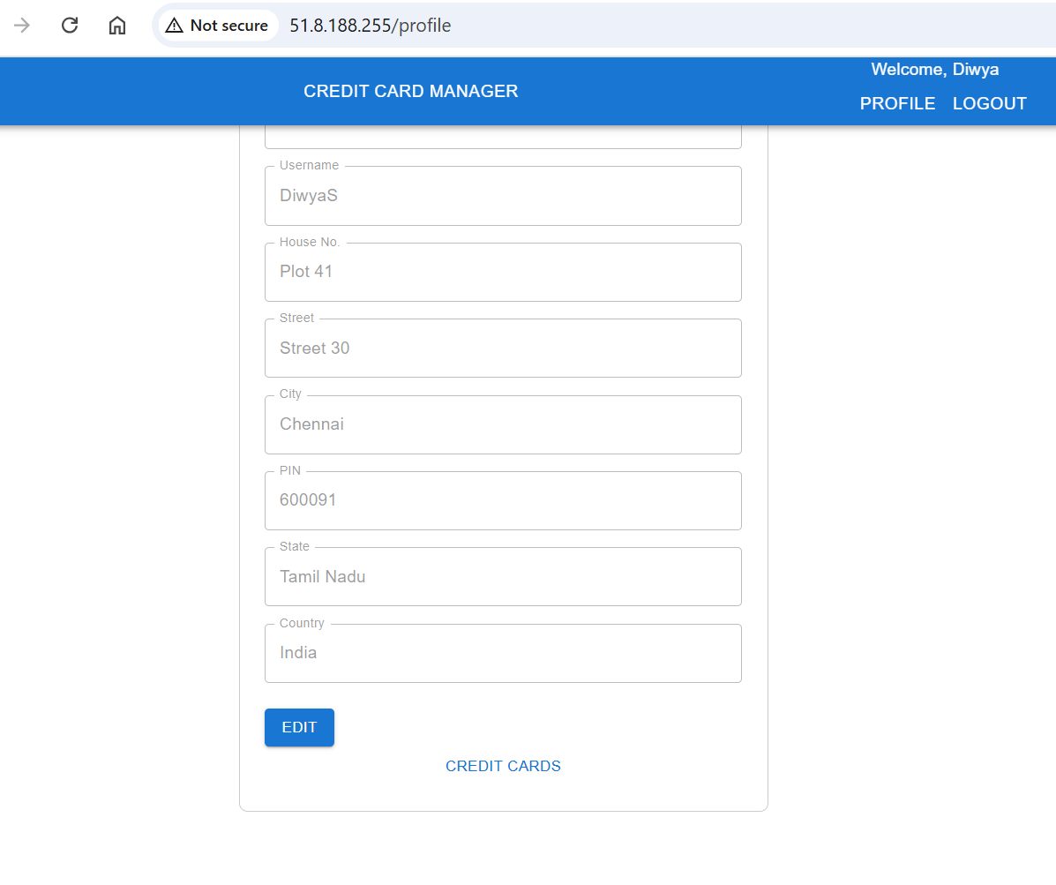
Capstone Project solution design & solution implementation
User Profile Page with Edit Option

Slide 20
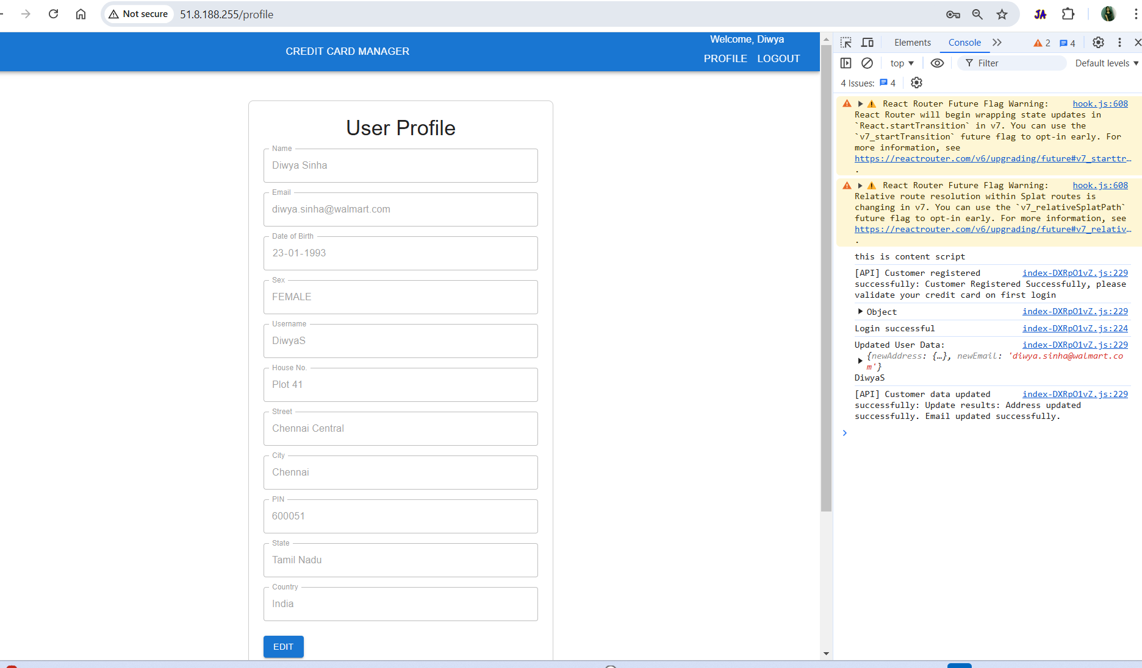
Capstone Project solution design & solution implementation
User Profile Page with Edit Option
Street and PIN Code has been changed by the user

Slide 21
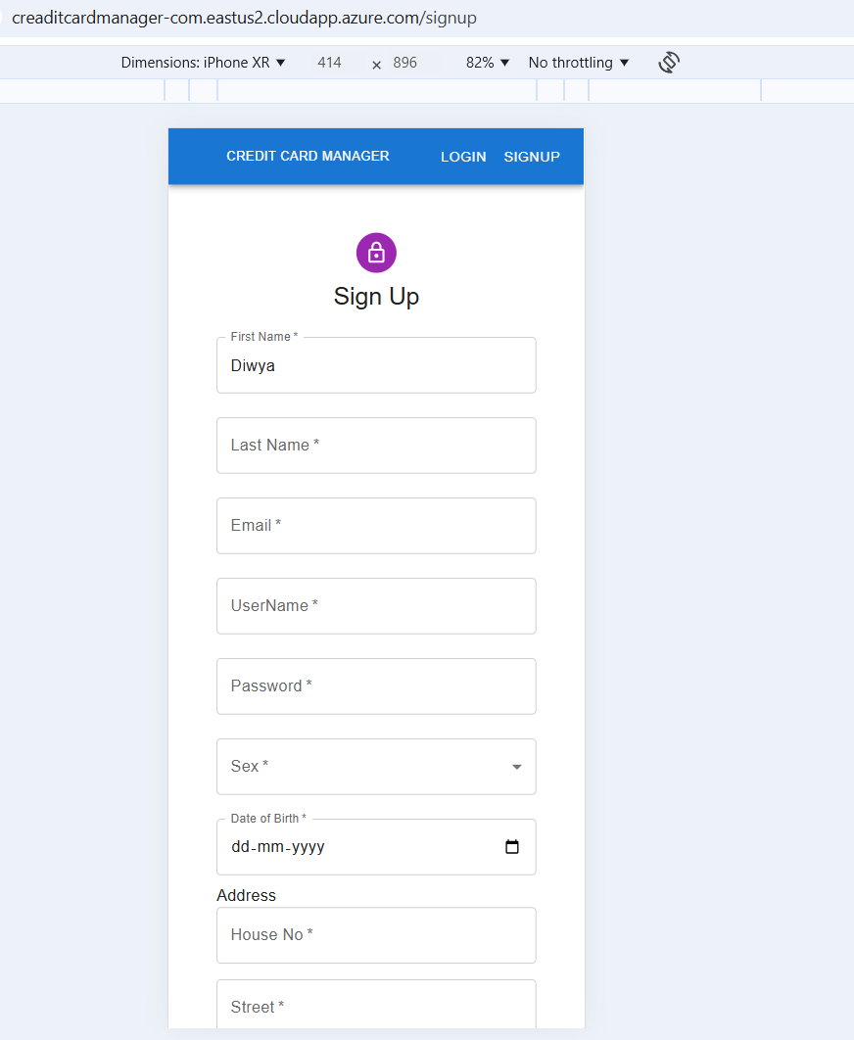
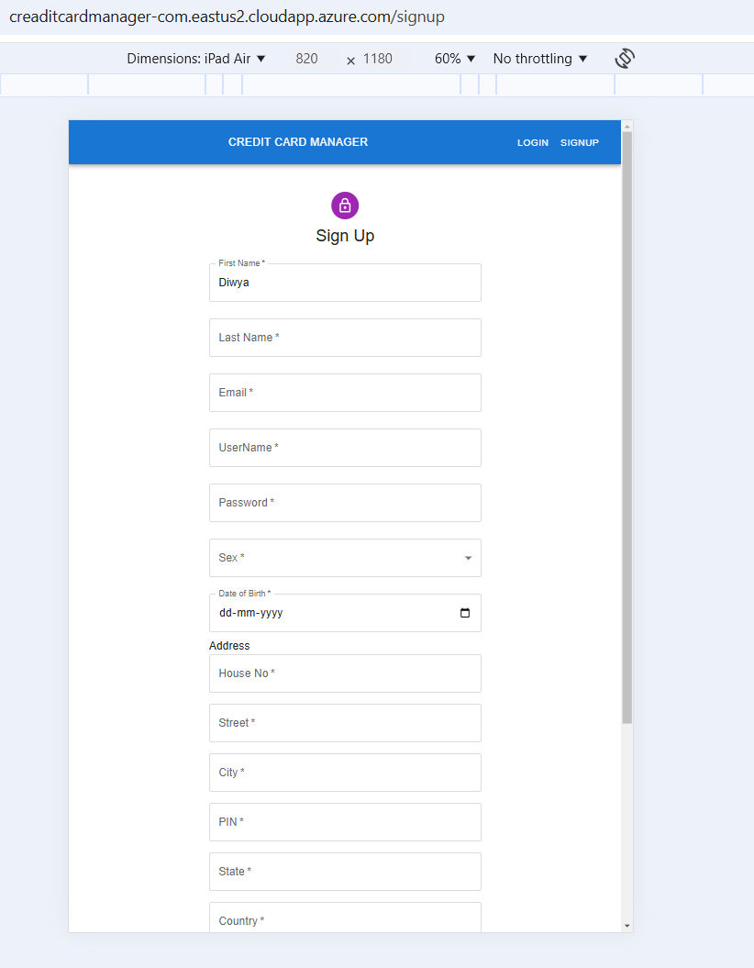
Capstone Project solution design & solution implementation
Application is responsive for Mobile/Desktop/Tablet

Slide 22
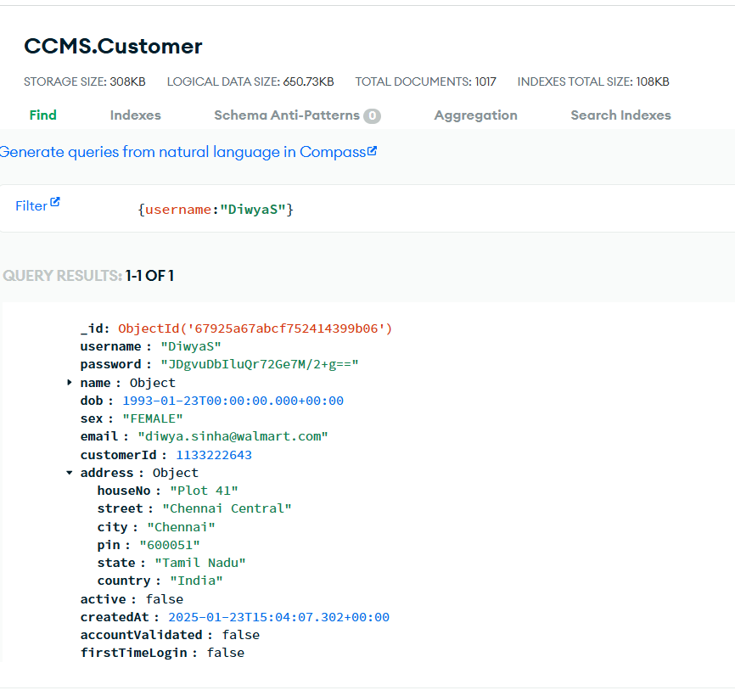
Capstone Project solution design & solution implementation
User Profile Page with Edit Option
Change of Street and PIN Code has been updated in the database

Slide 23
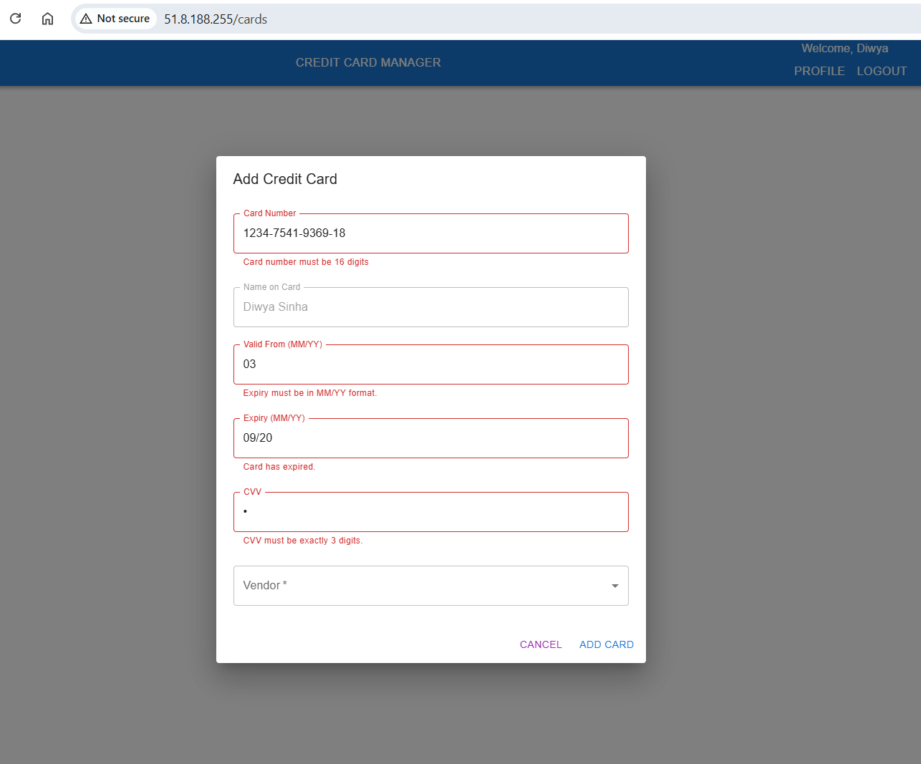
Capstone Project solution design & solution implementation
Adding Credit Card
Validation
Card Number: Must contain exactly 16 digits.
Valid From: Must follow the correct format (MM/YY); the same validation applies to the Expiry field.
Expiry: Requires validation to ensure the card expiration date is correct.
CVV: Must consist of exactly 3 digits.

Slide 24
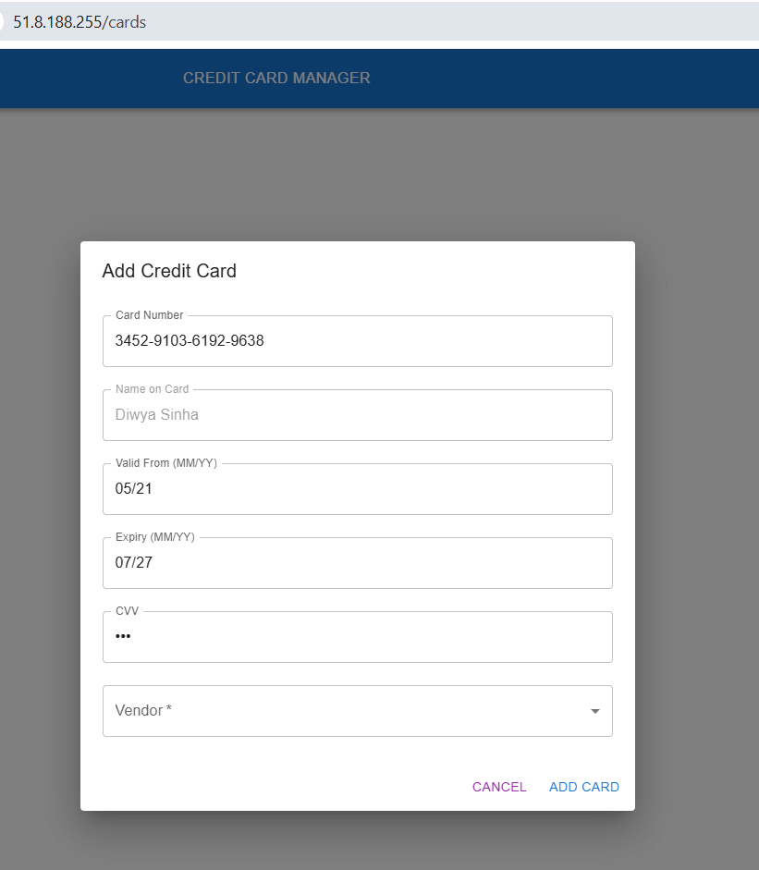
Capstone Project solution design & solution implementation
Adding Credit Card
On this screen, all the data is accurate. After completing all validations, the card can be added.

Slide 25
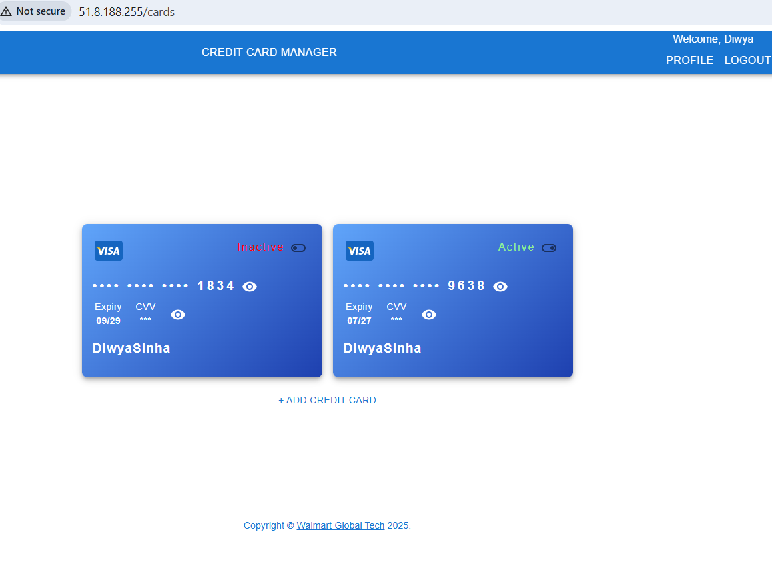
Capstone Project solution design & solution implementation
Adding Credit Card
After adding a credit card, the view will appear as in the screenshot
The card can be activated or deactivated.
The credit card number is masked to ensure security.
An eye icon allows the number to be temporarily revealed and will automatically hide it again after 5 seconds.

Slide 26
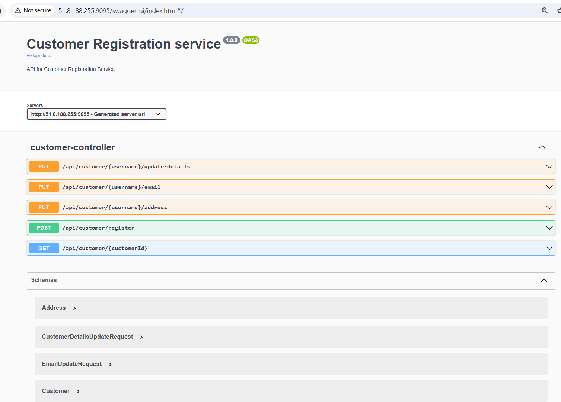
Capstone Project solution design & solution implementation
Customer Registration Service

Slide 27
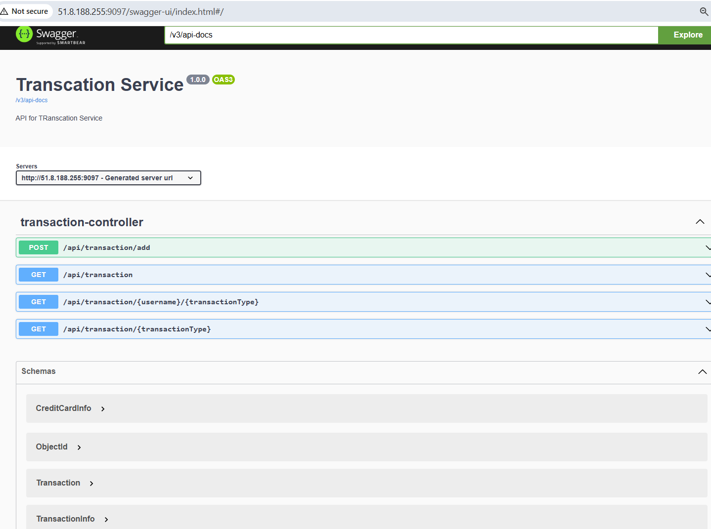
Capstone Project solution design & solution implementation
Transaction Service

Slide 28
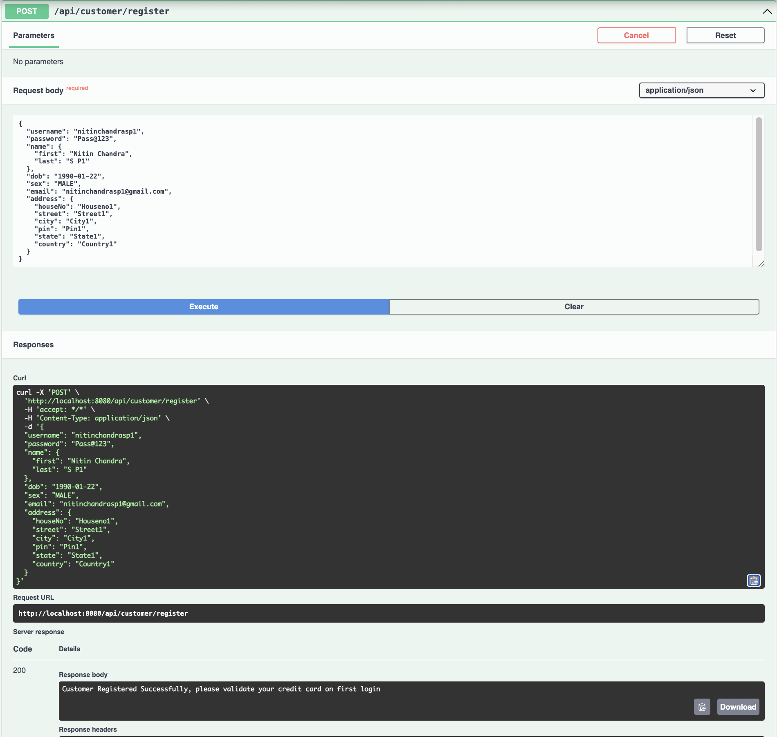
Capstone Project solution design & solution implementation
Backend Screenshots to be added from here
Register as customer valid case
Registering a new customer
Username: Minimum 6 characters, no special characters except _.
Password: At least 1 special character and 6 characters.
Credit Card: Valid format, multiple allowed.
Date of Birth: Must be at least 18 years old.
Gender: Only MALE, FEMALE, or TRANSGENDER.

Slide 29
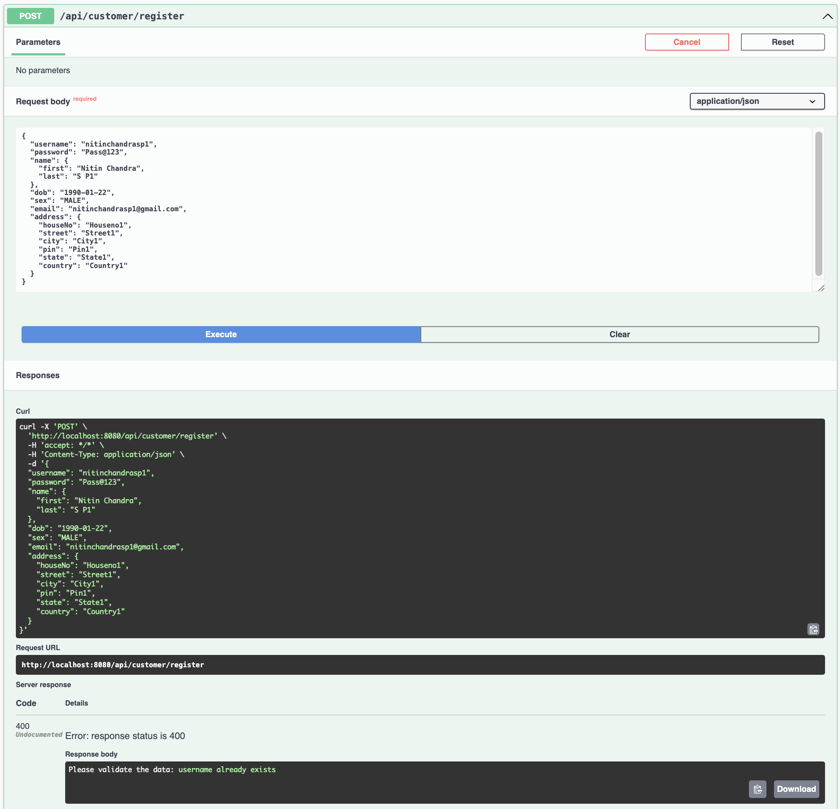
Capstone Project solution design & solution implementation
Register as customer invalid case
Attempt to register with a username that already exists in the database.
Response:
Please validate the data: username already exists

Slide 30
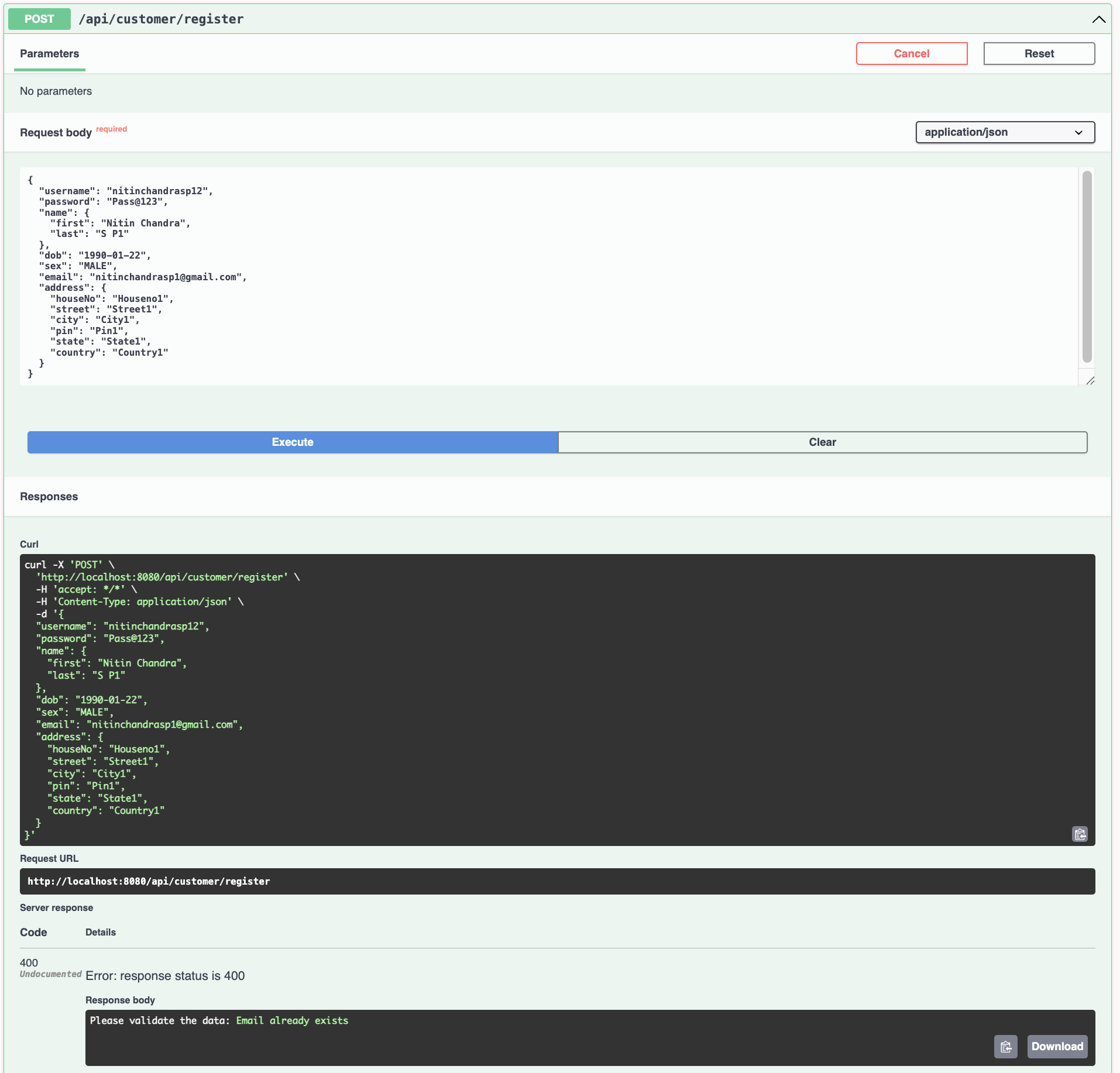
Capstone Project solution design & solution implementation
Register as customer invalid case
Attempt to register with Email that already exists in the database.
Response:
Please validate the data: Email already exists

Slide 31
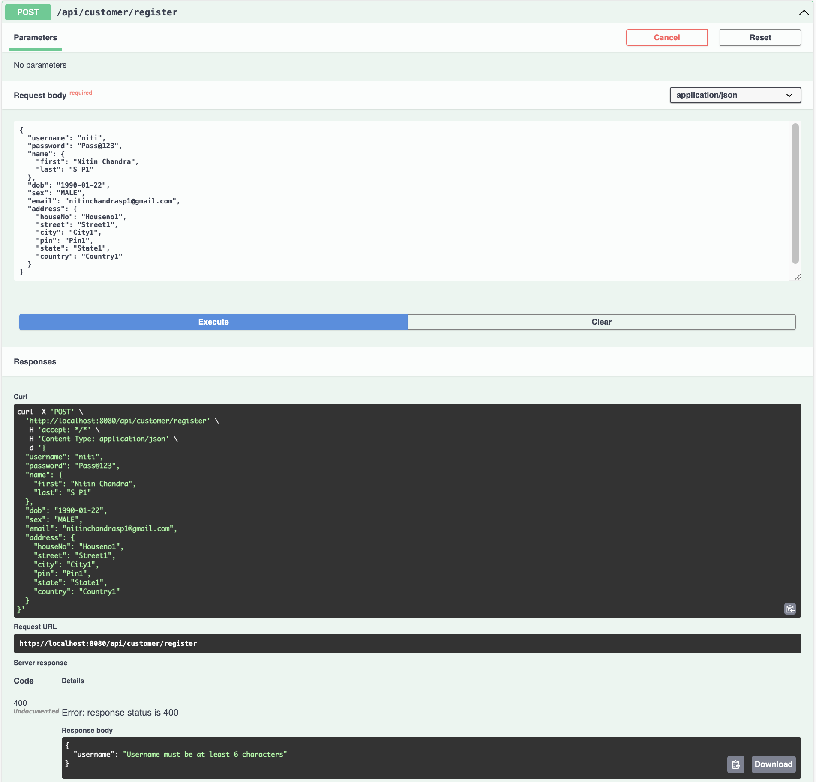
Capstone Project solution design & solution implementation
Register as customer invalid case
Attempt to register with username less than 6 character.
Response:
Please validate the data: Username should be at least 6 characters

Slide 32
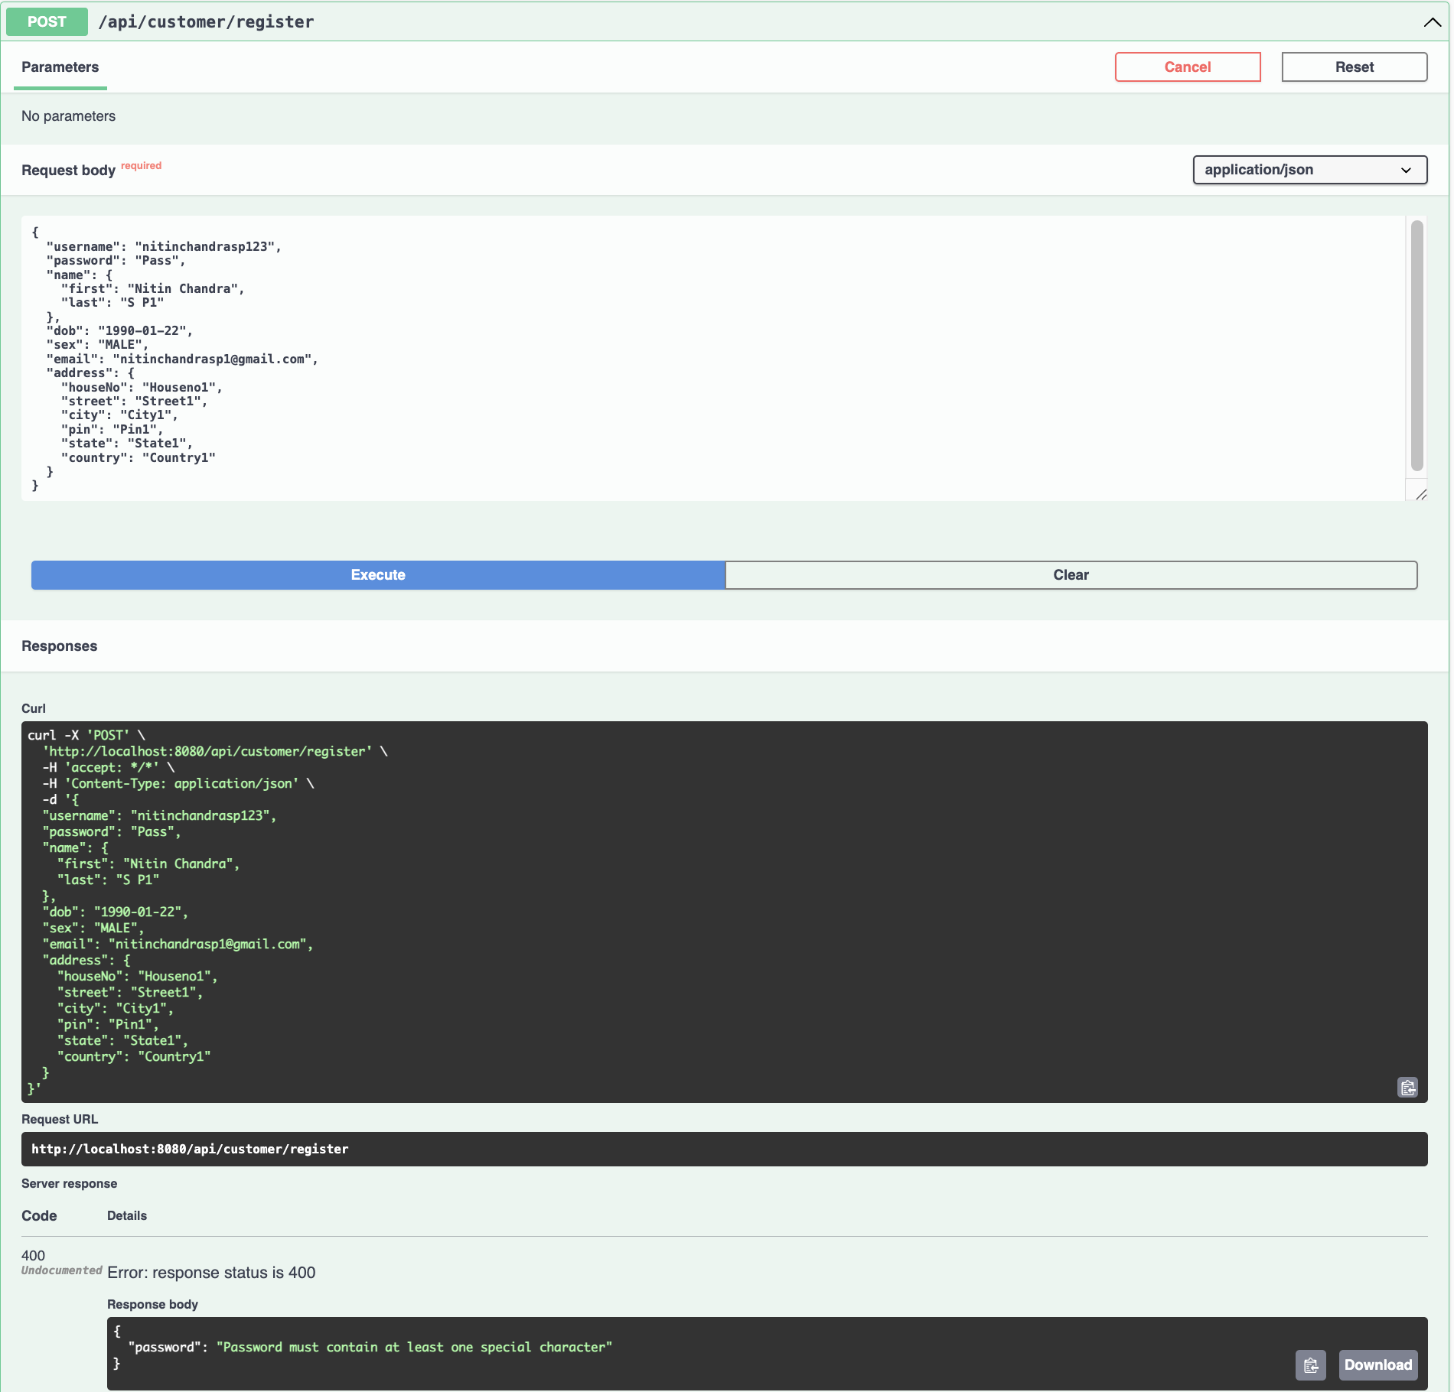
Capstone Project solution design & solution implementation
Register as customer invalid case
Attempt to register with Password without special character .
Response:
Please validate the data: Password must contain at least one special character

Slide 33
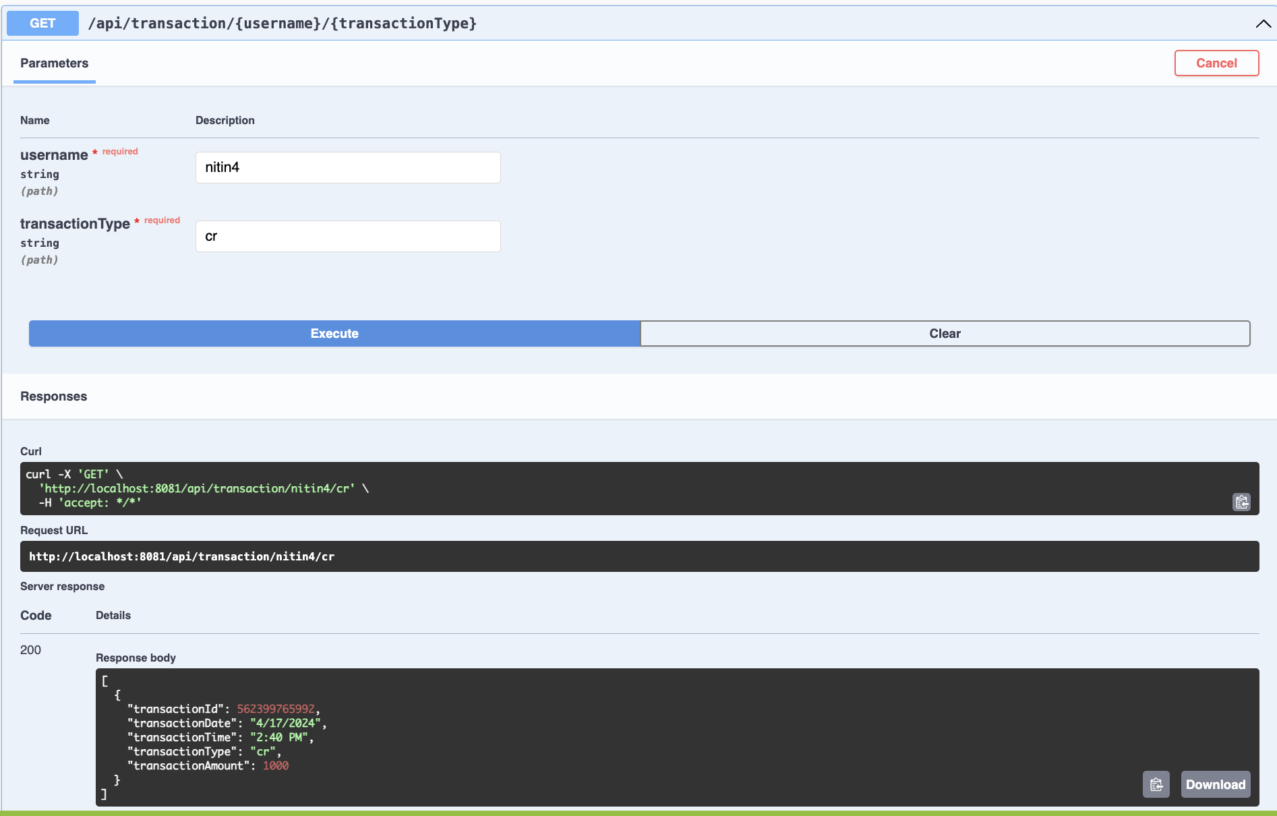
Capstone Project solution design & solution implementation
list the transaction based on description spent by user
Fetching the transaction of a user based on transaction type debit(db) or credit (cr)

Slide 34
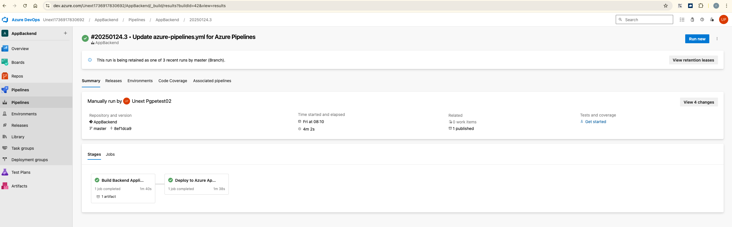
Capstone Project solution design & solution implementation
Dev-ops/Cloud Screenshot

Slide 35
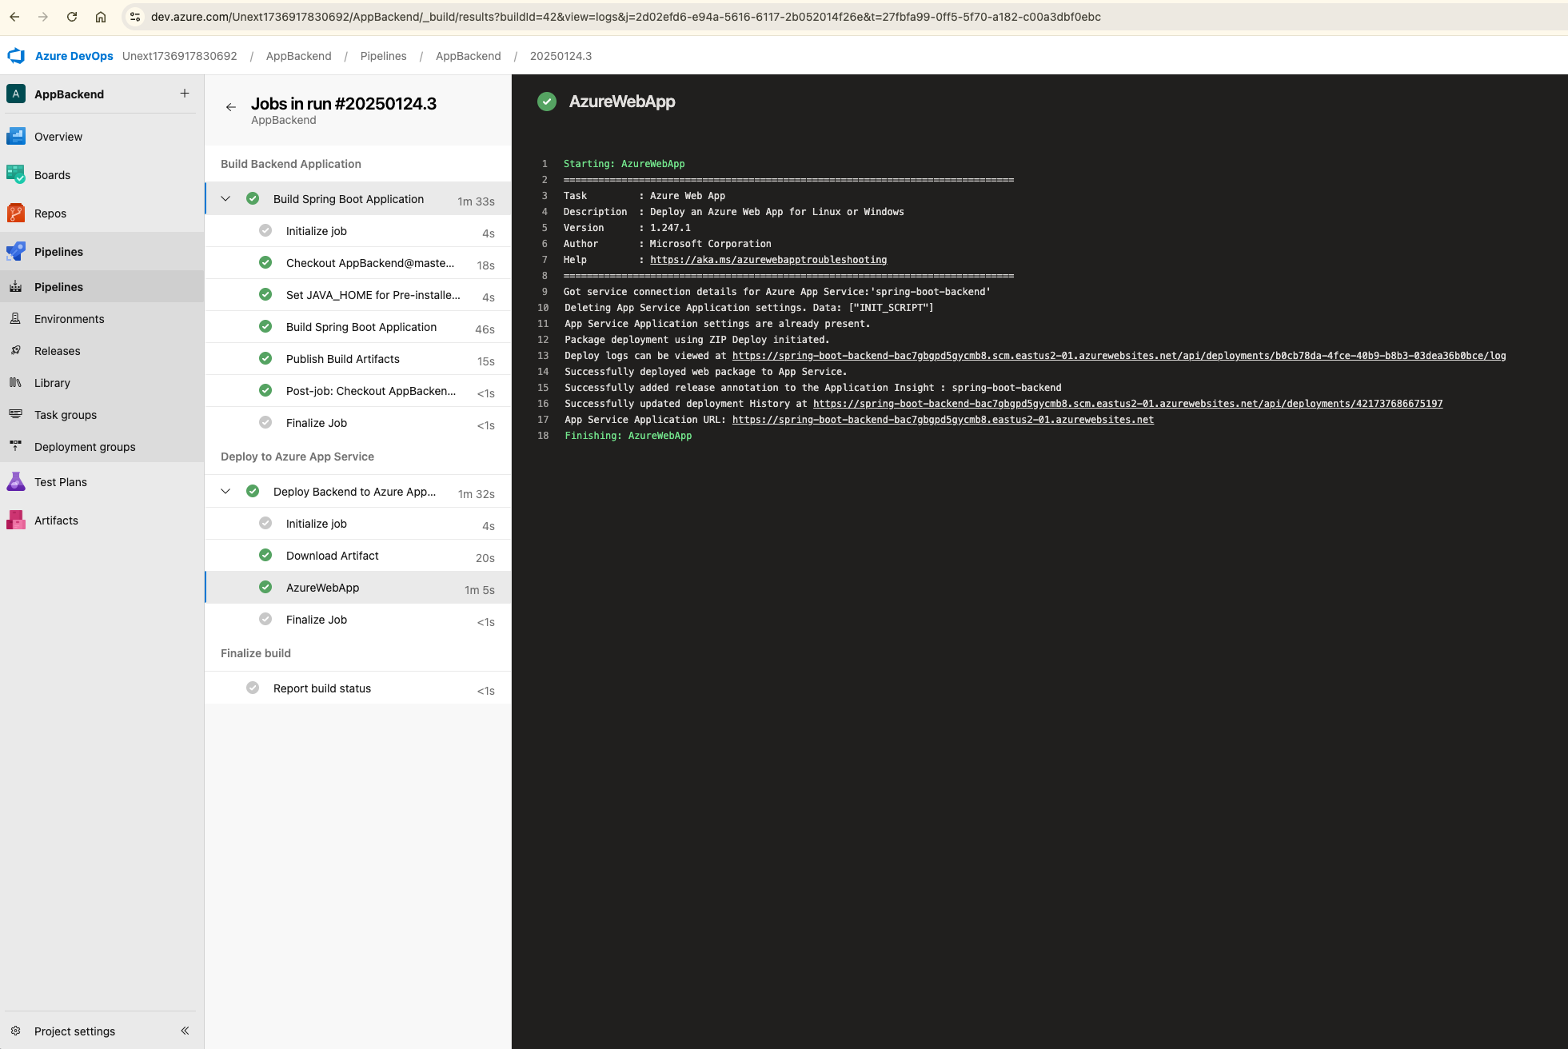
Capstone Project solution design & solution implementation
Dev-ops/Cloud Screenshot

Slide 36
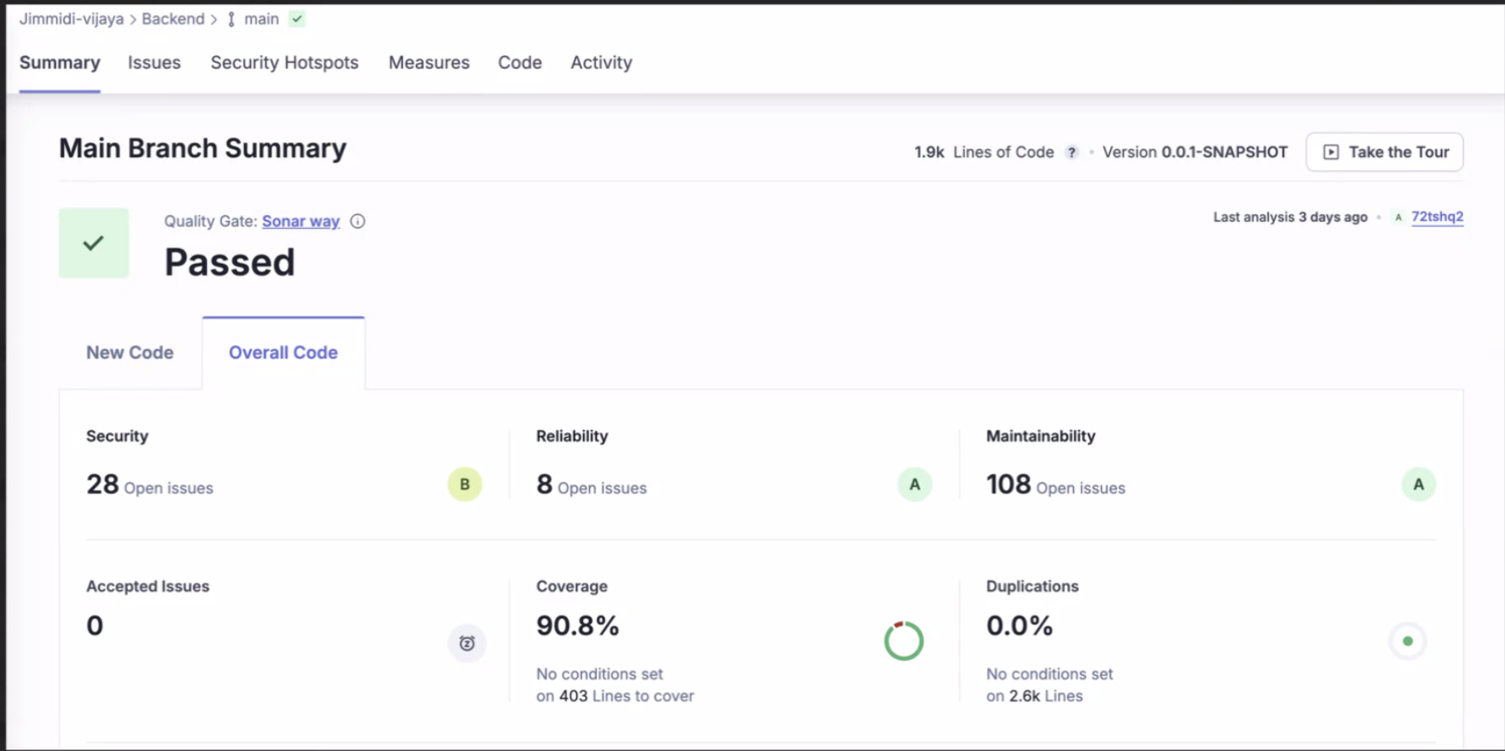
Capstone Project solution design & solution implementation
Sonar - Code Coverage and Quality
SonarQube is used to enforce code quality and code coverage of 90.8 %

Slide 37
Technology Slack
Frontend
React.js + Vite: For building a fast, responsive, and dynamic user interface with optimal development and build performance.
Material UI (MUI): For leveraging pre-designed components and themes to create a modern, professional, and responsive design.
JavaScript: For adding interactivity and managing frontend logic.
Backend
Java: As the programming language for backend development.
MongoDB: For storing and managing data in a NoSQL database.
Spring Boot: For building a scalable, robust, and RESTful API-based backend
Devops & Cloud
GitHub: For version control and source code management.
Docker: For containerizing the application for consistent development and deployment
SonarQube: For maintaining code quality and validating test cases.
Postman: For API testing and validation.
Swagger: For API documentation and testing during development.
Compute: Azure Virtual machine
CI/CD: Azure Pipeline

Slide 38
Non Functional Requirements
Performance
API response time should not exceed 300 milliseconds under normal load.
The system must handle concurrent users without noticeable latency.
Security
Passwords must be encrypted using strong hashing algorithms(AES 256) before storage.
Sensitive data (Credit card numbers, CVV) must not be transmitted or stored without encryption.
Authentication must use secure methods, such as JWT, to prevent unauthorized access.
Availability
The system should have a minimum uptime of 99.9% to ensure continuous availability.
Maintainability
Codebase should be modular, well-documented, and adhere to industry best practices for easy maintenance.
SonarQube should be used to enforce code quality, with at least 90% test coverage.
Compatibility
The system should work on all major browsers (Chrome, Firefox, Safari, Edge) and devices (iOS, Android).
APIs should follow RESTful standards to ensure compatibility with third-party integrations.

Slide 39
Best Practices followed under implementation
Input Validation: Ensure proper validation for registration forms and transaction searches both on the client and server side.
Secure Data Handling: Use secure methods like hashing for passwords and masking of credit card and CVV to avoid security vulnerabilities.
Error Handling: Provide meaningful error responses and ensure graceful handling of invalid cases.
Responsive Design: Ensure the app is mobile-friendly by using Material UI components.
State Management: Use React state management (or Context API) to handle user input and form submissions.
Quality Assurance: Use SonarQube for code quality checks and enforce coding standards in the pipeline.
Docker & MongoDB Replication: Use Docker for containerization and set up MongoDB replication for high availability.
Responsive Deployment: Design for responsiveness ensuring the app performs well across devices and in the cloud.

Slide 40
Challenges faced during solution design and Implementation
Challenges in Solution Design
Requirement Ambiguity- Some user stories and requirements were unclear or open to interpretation, making it hard to design an optimal solution.
Challenges in Solution Implementation
Data Handling and Syncing- Managing state and data between the frontend and backend, especially for features like transaction listing, customer registration, and account settings.
Device Compatibility-Ensuring that the frontend worked across multiple browsers and devices, particularly given the use of Material UI components.
Security and Data Privacy-Ensuring that sensitive information (e.g., credit card data, CVV) was securely handled and stored.
Team Coordination and Collaboration- Ensuring smooth communication between frontend and backend team and then across the three teams.
Cloud Accessibility issues- Azure App Service and Azure DevOps not worked as expected.(No hosted parallelism has been purchased or granted. To request a free parallelism grant)

Slide 41
Individual Contribution
Nitinchandra Sp
Register as customer valid case
Contract Documentation(REST APIs)
Vijaya Jimmidi
Register as customer invalid case
List the transaction based on description spent
Atul Pahlazani
Customer Registration
View the list of credit cards
Add Credit Cards*
Customer Login*
Diwya Sinha
Customize account settings/Edit account settings
Dockerization
Documentation/PPT
Venkatarami Reddy Challa
Customer registration - email validation
Cloud Setup and hosting
Pipeline Configuration

Slide 42
Learning and Experience
The project provided a valuable experience in both technical skills and teamwork. On the technical side, it helped refine expertise in frontend development, backend API design, database optimization, and cloud deployment. On the soft skills side, it enhanced the abilities to collaborate effectively within a cross-functional team and communicate clearly to solve challenges as they arose. The entire process has significantly improved individual ability to design, implement, and deploy full-stack applications.
Frontend- Gained expertise in React and Material UI, focusing on building responsive, user-friendly interfaces. Improved skills in form handling, validation, and state management using React hooks and Context API.
Backend- Learned to design RESTful APIs, implement JWT authentication, and handle database operations with MongoDB. Gained insights into server-side validation and data consistency.
DevOps and Cloud Infrastructure- Gained hands-on experience with CI/CD pipeline setup using GitHub Actions, Docker for containerization, and cloud services like Azure Virtual Machine, Azure app service, Azure DevOps.

Slide 43
Future Scope
This Current project provides ample opportunity to scale the application for better functionality, security, and user experience while addressing evolving user needs. Some of the options which we can consider for future enhancement:-
Building a personalized dashboard with spending insights and graphs.
Enhancing the transaction features by adding filters for transactions based on date, amount, and categories.
Enabling email/SMS notifications for specific transaction activities or threshold spending limits.
Enabling Advanced Customization by allowing users to set themes (dark/light mode, custom colours).

Slide 44
Thank You

